Slide 1

The Grid Transition – 2026
“a short (data intensive) summary”

Slide 2
OPALCO Member Survey on Energy Reliability and Local Renewable Development
December 2025
“Stop using scare tactics like those in this survey….”
Hmmm? What is there to be scared of…

Slide 3
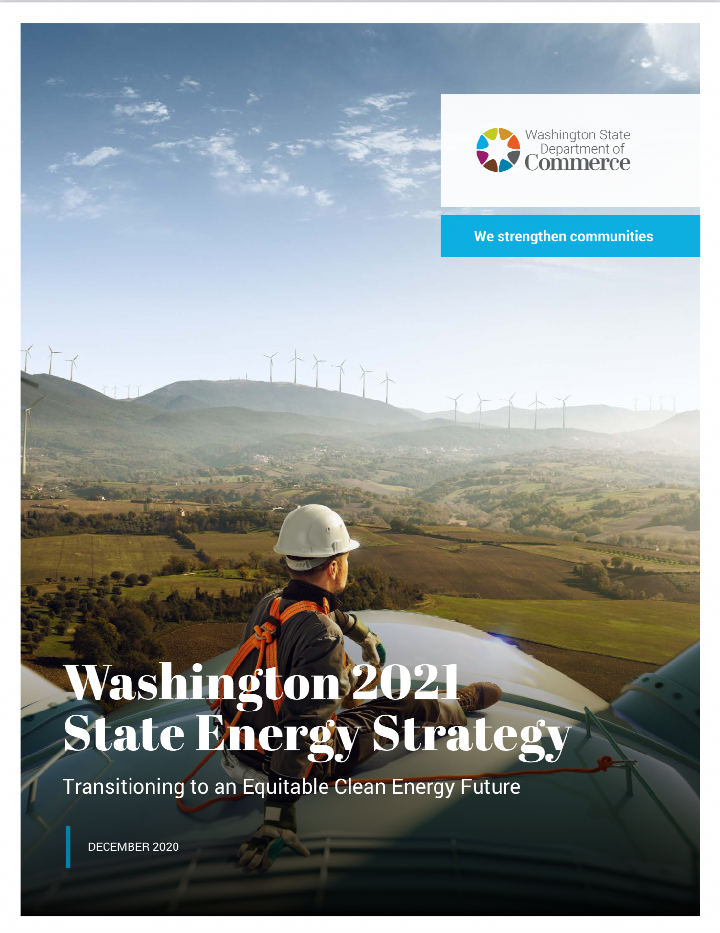
Major WA State Climate Legislation
- Climate Commitment Act (CCA- SB 5126)
- Clean Energy Transformation Act (CETA -SB 5116)
- HB 1181 - 2023-24
“Improving the state's response to climate change by
updating the state's planning framework.”
- Energy Independence Act I-937 requires electric utilities
to use renewable energy and energy conservation.
The 2021 State Energy Strategy is designed to provide a roadmap for meeting the state’s greenhouse gas emission limits.
Enacted in 2020, the CCA commits Washington to limits of:
-45% below 1990 levels by 2030,
-70% below 1990 levels by 2040 and
-95% below 1990 levels
with net zero emissions by 2050
-140 pages

Slide 4
Washington imports 43% of its clean energy from inland wind-rich states (Montana and Wyoming) in the Electri-fication Scenario in 2050. The increased energy flows across multiple states and balancing areas will require investment in new transmission and the efficient use of imports as a balancing resource
Washington has limited build of in-state renewable resources in all decarbonization scenarios until 2040. Prior to that, it is more cost effective to import clean energy from cheaper out-of-state sources. Between 2040 and 2050, Washington adds solar and offshore wind (12 GW and 4 GW, respectively, in the Electrification Scenario).

Slide 5
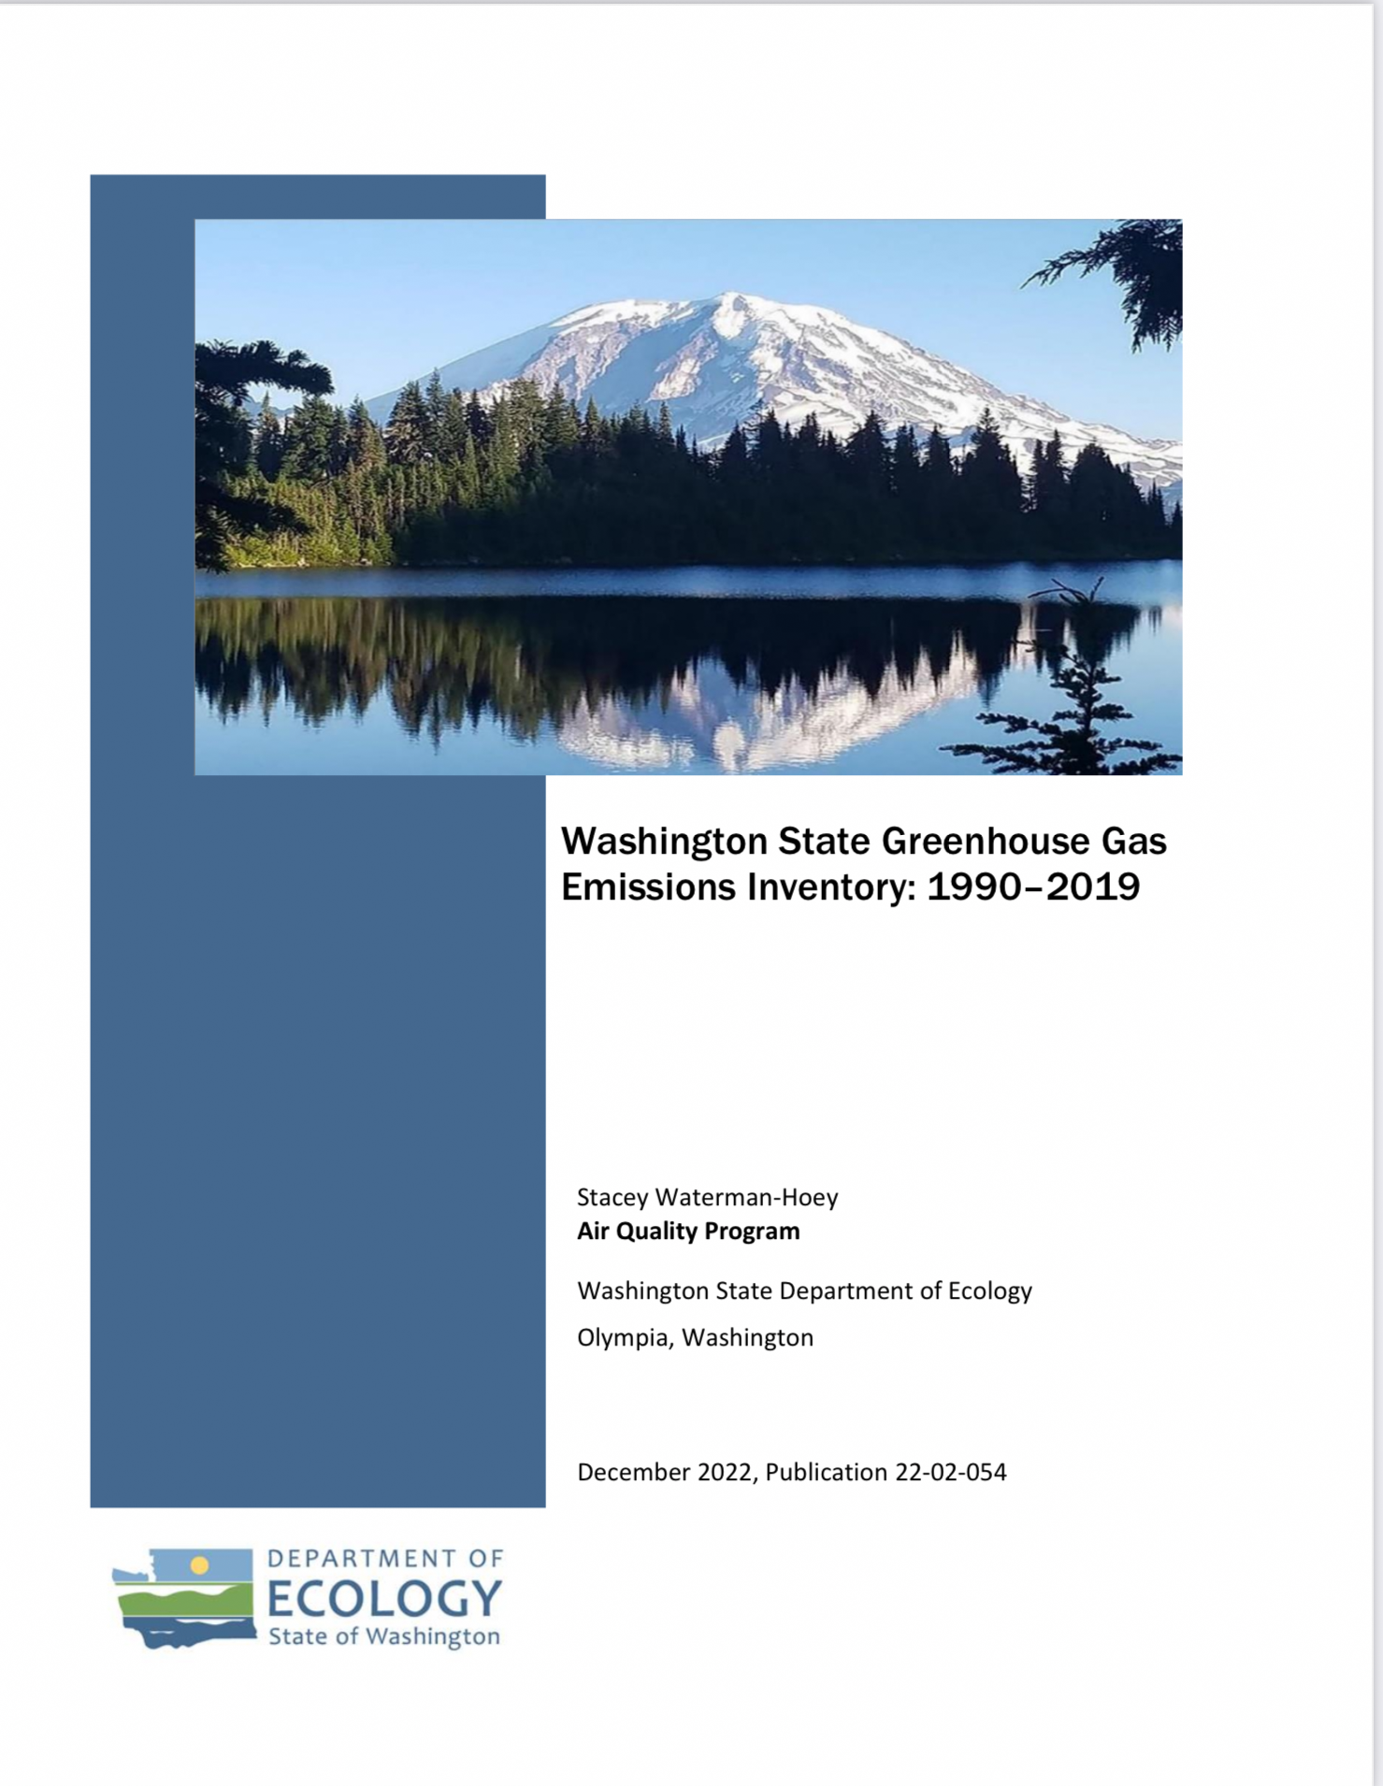
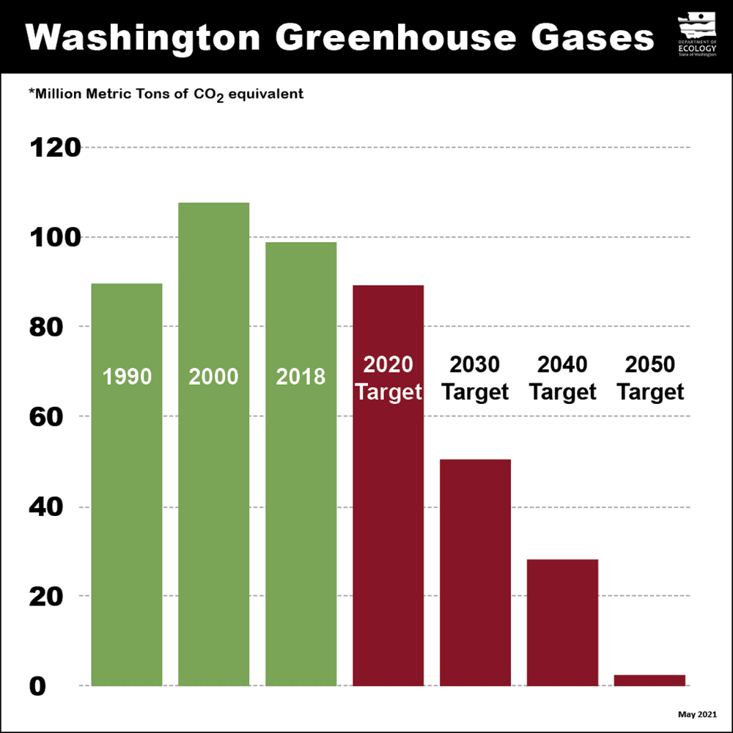
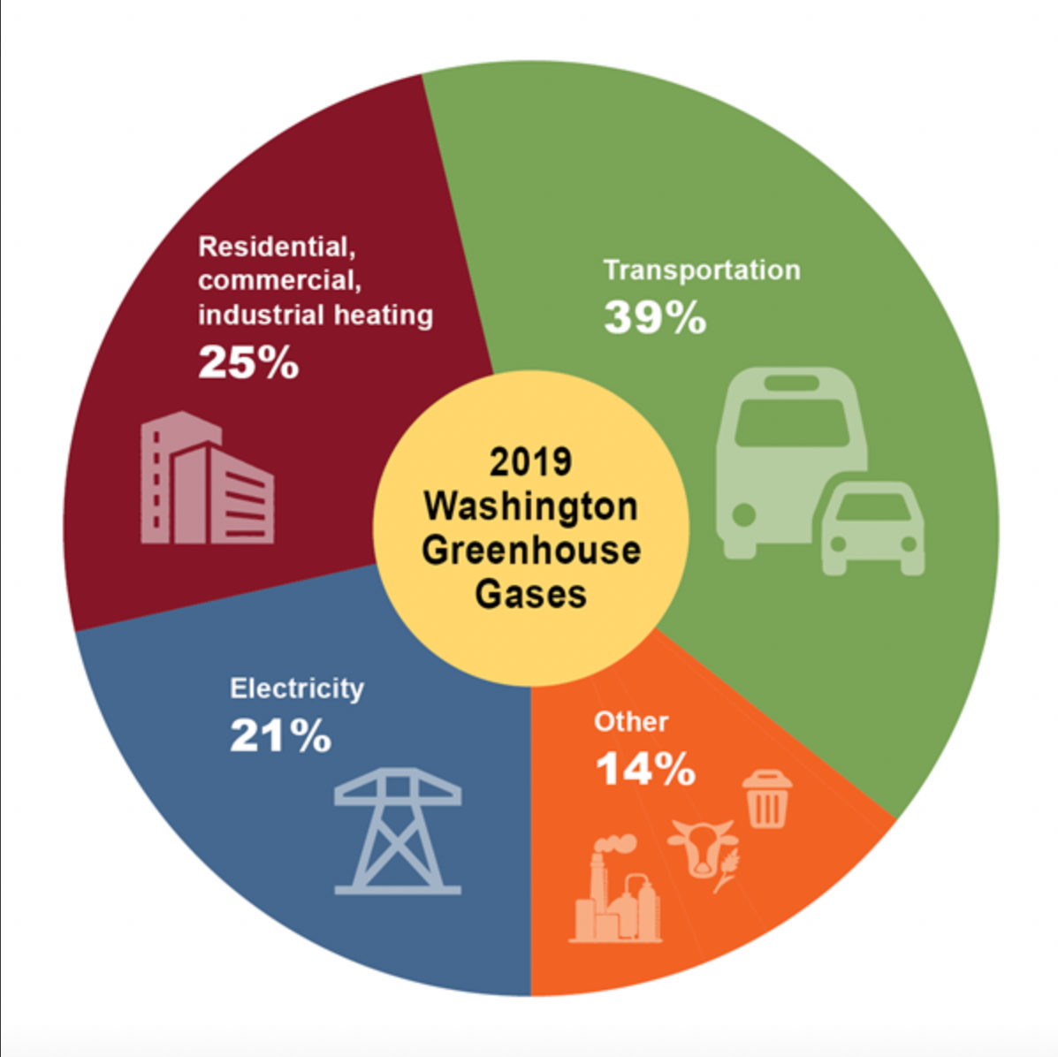
With the current lag pattern Ecology itself is signaling, the state likely won’t have an “official inventory” answer for the 2030 goal until December 31, 2033 (give or take).
Washington State
Total gross emissions MMTCO2e
Year Amount Goal
1990 93.5 2030 51.4
2000 111.0 2040 28.1
2010 95.0 2050 4.7
2015 94.6
2016 95.1
1017 95.3
2018 95.5
102.1 From 2021 to 2030…
2020 88.3 96.1 to 51.4 = -47% 2021 96.1
4 years from now!
https://apps.ecology.wa.gov/publications/documents/2202054.pdf
-51 pages

Slide 6
WA State Aggregate Fuel Mix for Utilities 2021 – 2050?
Solar
Nuclear
Wind
❌
Coal
Hydro
❌
❌
Nat Gas
https://www.commerce.wa.gov/wp-content/uploads/2023/08/2022-FMD-Report.pdf

Slide 7
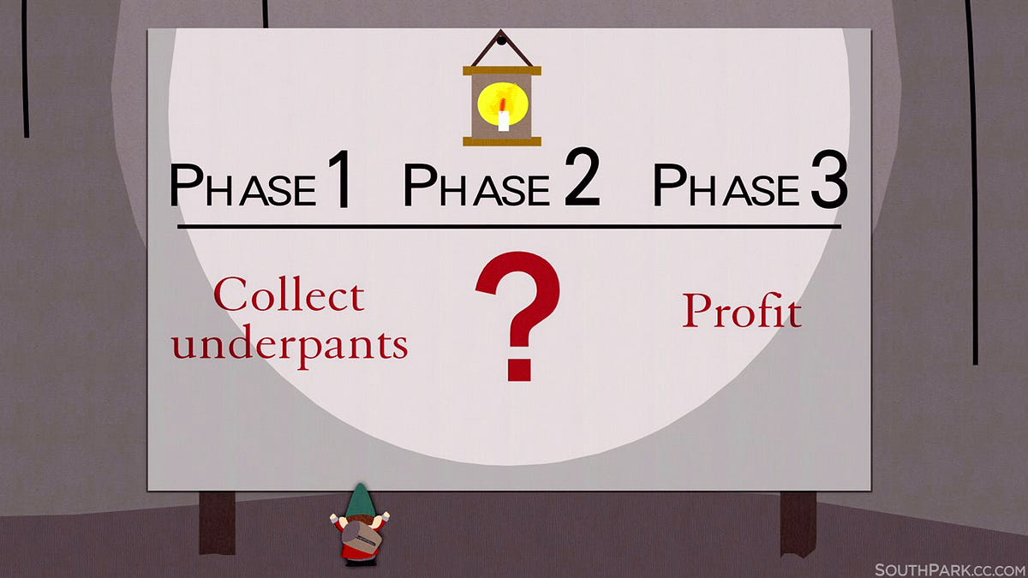
South Park episode
December 16, 1998 | Season 2 Episode 17
https://en.wikipedia.org/wiki/Gnomes_(South_Park)

Slide 8
“Green-the-Grid!”
“Net-Zero 2050”

Slide 9
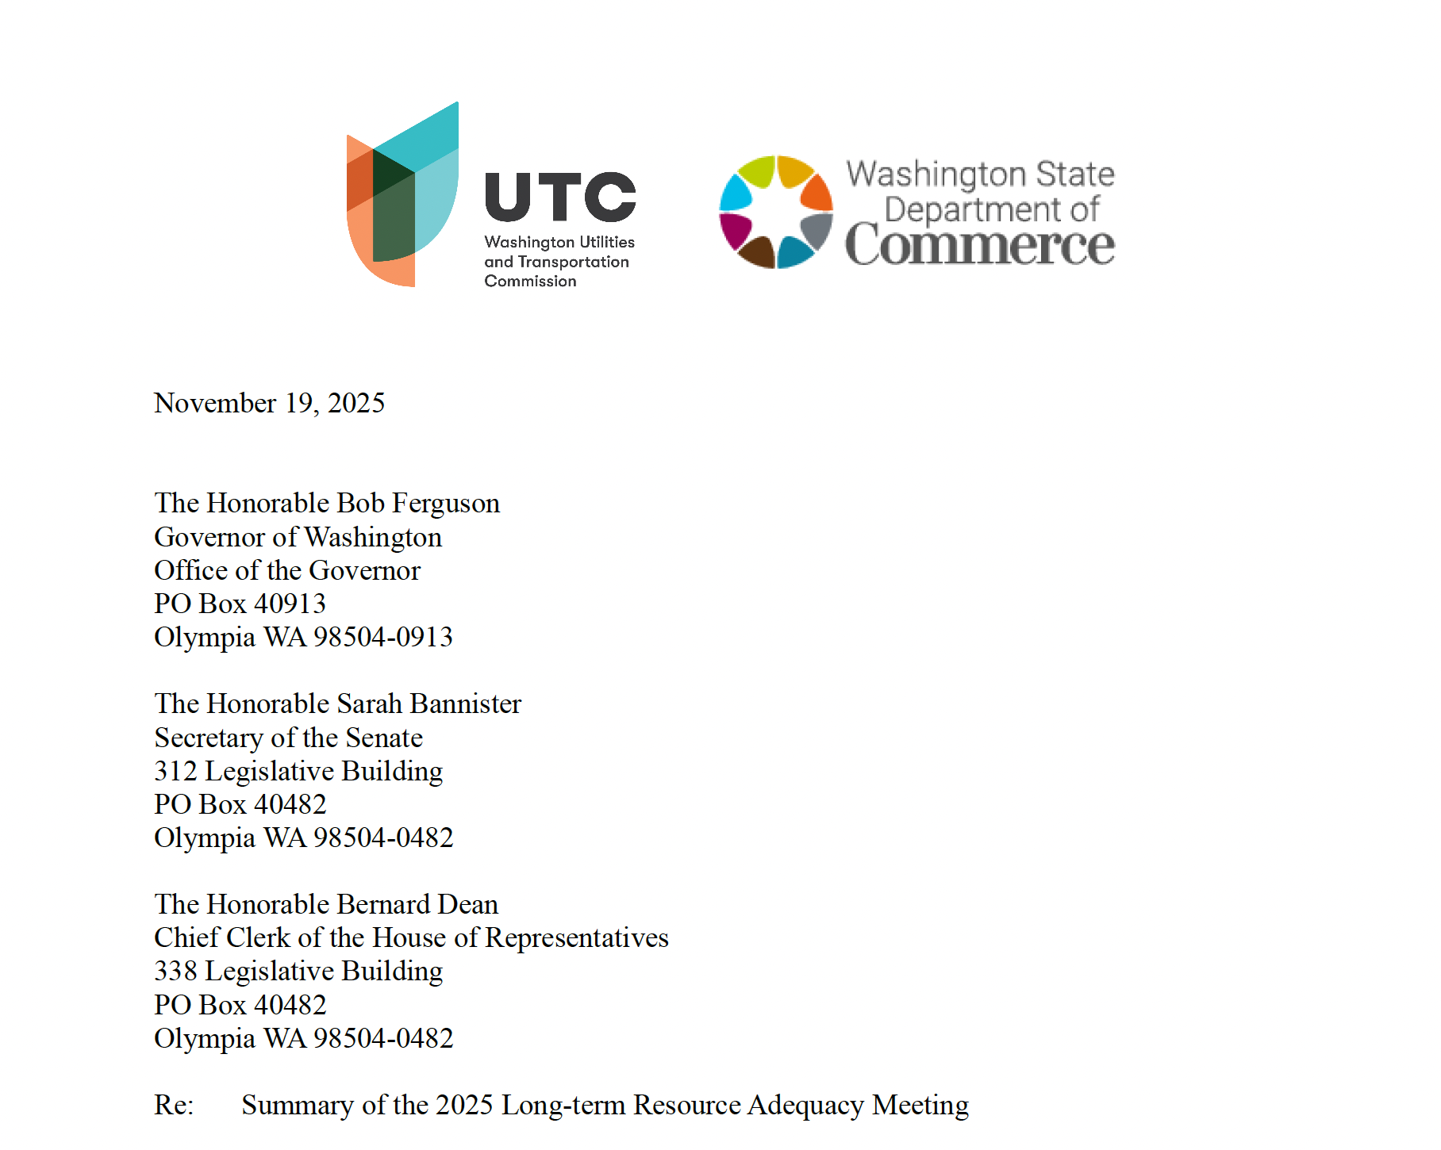

Slide 10
What it says in plain English
Bottom line: The Northwest grid is assessed as “normal risk” for resource adequacy in the near and medium term, meaning it meets national adequacy criteria under many conditions—but “normal risk” ≠ “no risk.”
The big worry: load growth + more extreme weather could turn “normal” into real reliability trouble—especially if new large loads (notably data centers) materialize and if the region can’t actually build/plug in resources fast enough.
The repeated theme: Resource adequacy is increasingly about critical periods (e.g., extreme cold + low hydro + low wind) and transmission deliverability, not just annual energy.
Key facts and claims the report highlights
Potential gap magnitude: Under some forecasts, if the region added no new generation capacity by 2030, it would face a ~9 GW resource gap—described as roughly the current electricity requirements of Oregon. The report says existing utility IRPs show that gap closing—but it immediately warns that assumptions are fragile.
Load forecast uncertainty: There’s limited visibility into whether large load interconnection requests (including data centers) are duplicative or speculative, and planned resource additions are “less predictable than in recent history.”
New resource headwinds: It calls out three big blockers to getting new resources online:
changes in federal policy and increased costs,
lack of transmission capacity, and
permitting and interconnection challenges.

Slide 11
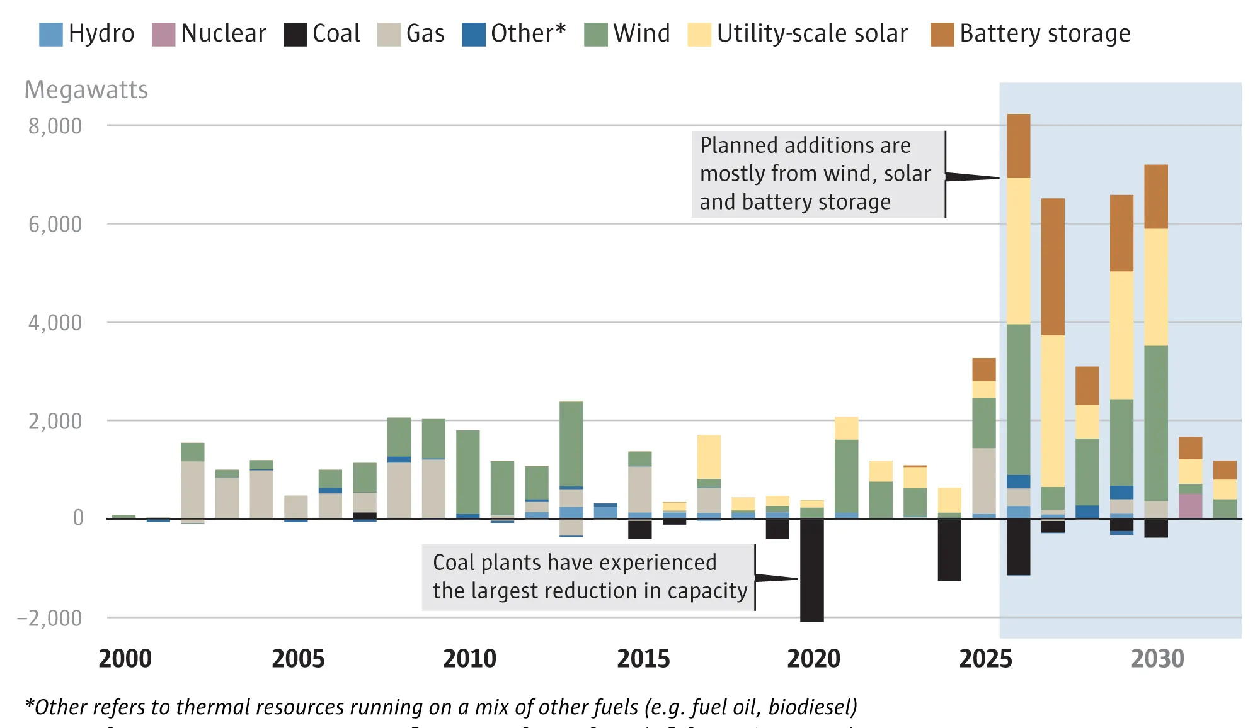
Resource Adequacy and the Energy Transition in the Pacific Northwest: Phase 1 Results - Page 21
Washington Utilities and Transportation Commission Washington Department of Commerce
Resource Adequacy Meeting, RCW 19.280.065, Docket UE-210096 September 22, 2025
When Commerce says “planned additions,
” it’s usually shorthand for:
• Utility plans (IRPs/CEIPs) +
• WECC rollups (ADS/WARA)
Those sources do not require that a
project is financed, permitted, has
assigned transmission upgrades, or
has begun construction.
The rate of new resource additions required to meet resource adequacy needs in the next five years is unprecedented

Slide 12
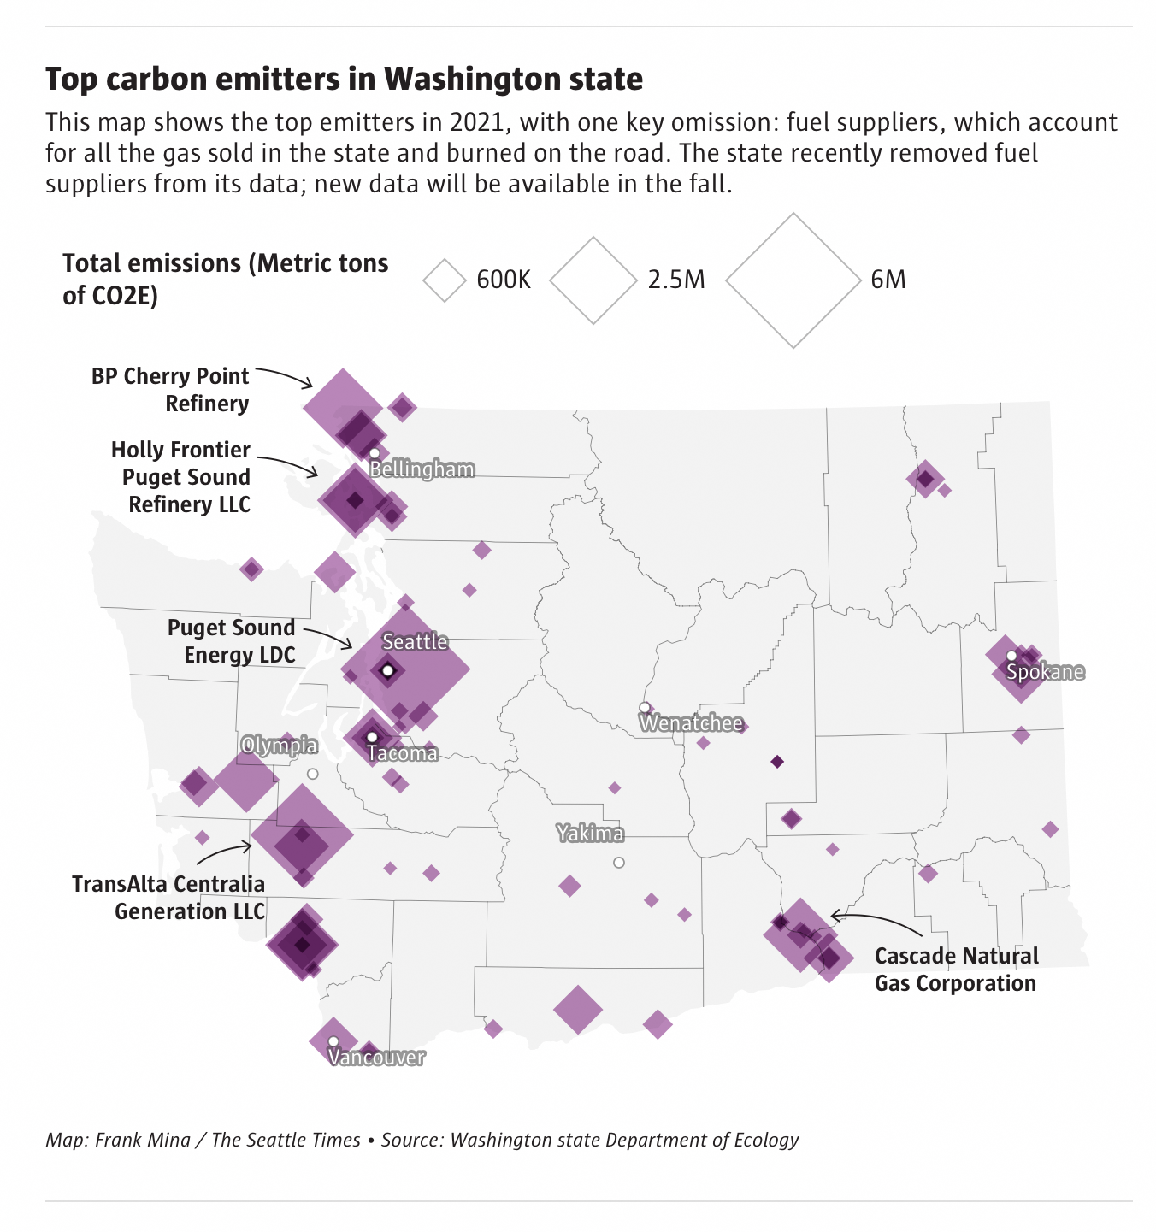
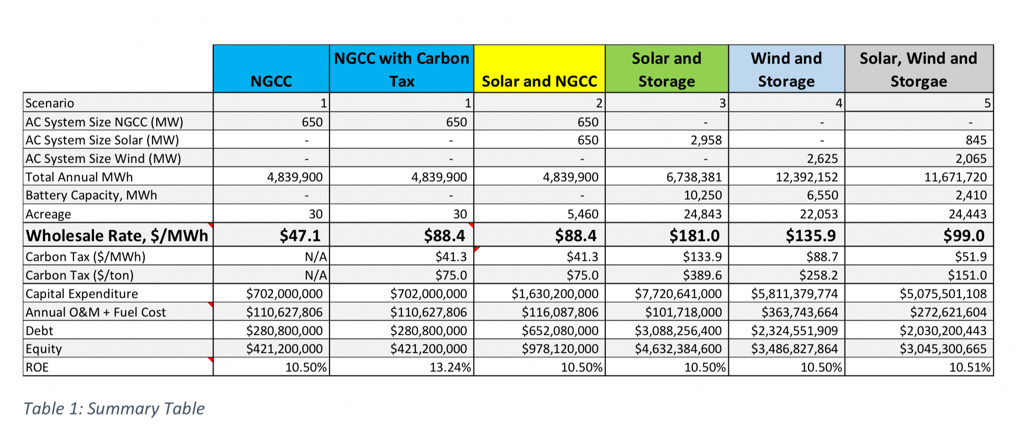
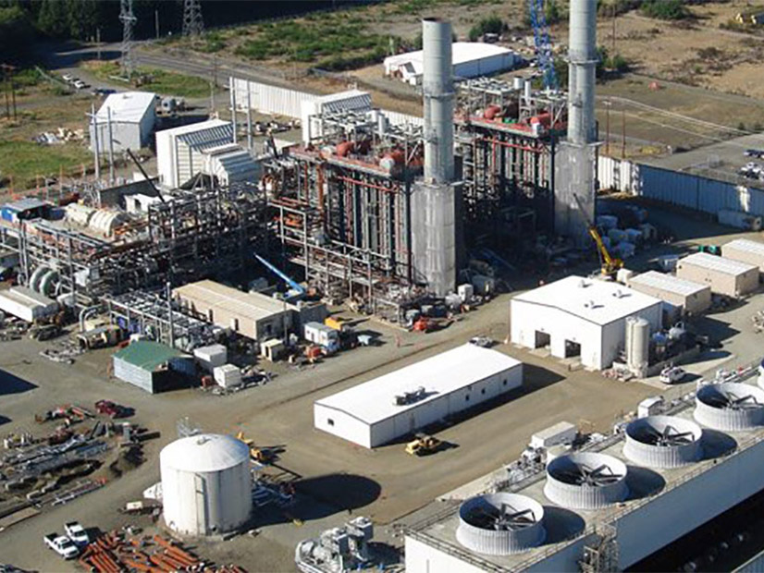
Replacement of Gray’s Harbor Energy Center
650MW Gas Turbine Generating Plant
with Wind and Storage (a “wicked” problem)
CapEx: $5.8B Area: 22,000 acres ( 34 sq. mi.)
[-Gray’s Harbor Energy center is located on a 20-acre site within the
Satsop Redevelopment Park in Grays Harbor County
-Lopez+Shaw islands area: 37 sq.mi.]
“MEASURING RENEWABLE ENERGY AS BASELOAD POWER”
UNC Kenan-Flagler Business School – Page 12

Slide 13
https://www.bpa.gov/energy-and-services/transmission/interconnection
“On top of that, in May of this year, Bonneville Power said it had 208 gigawatts worth of generation projects requesting to connect to its transmission grid. That is a whopping 208,000 megawatts asking to get on BPA’s grid.”
July 29, 2024 – reader comment

Slide 14
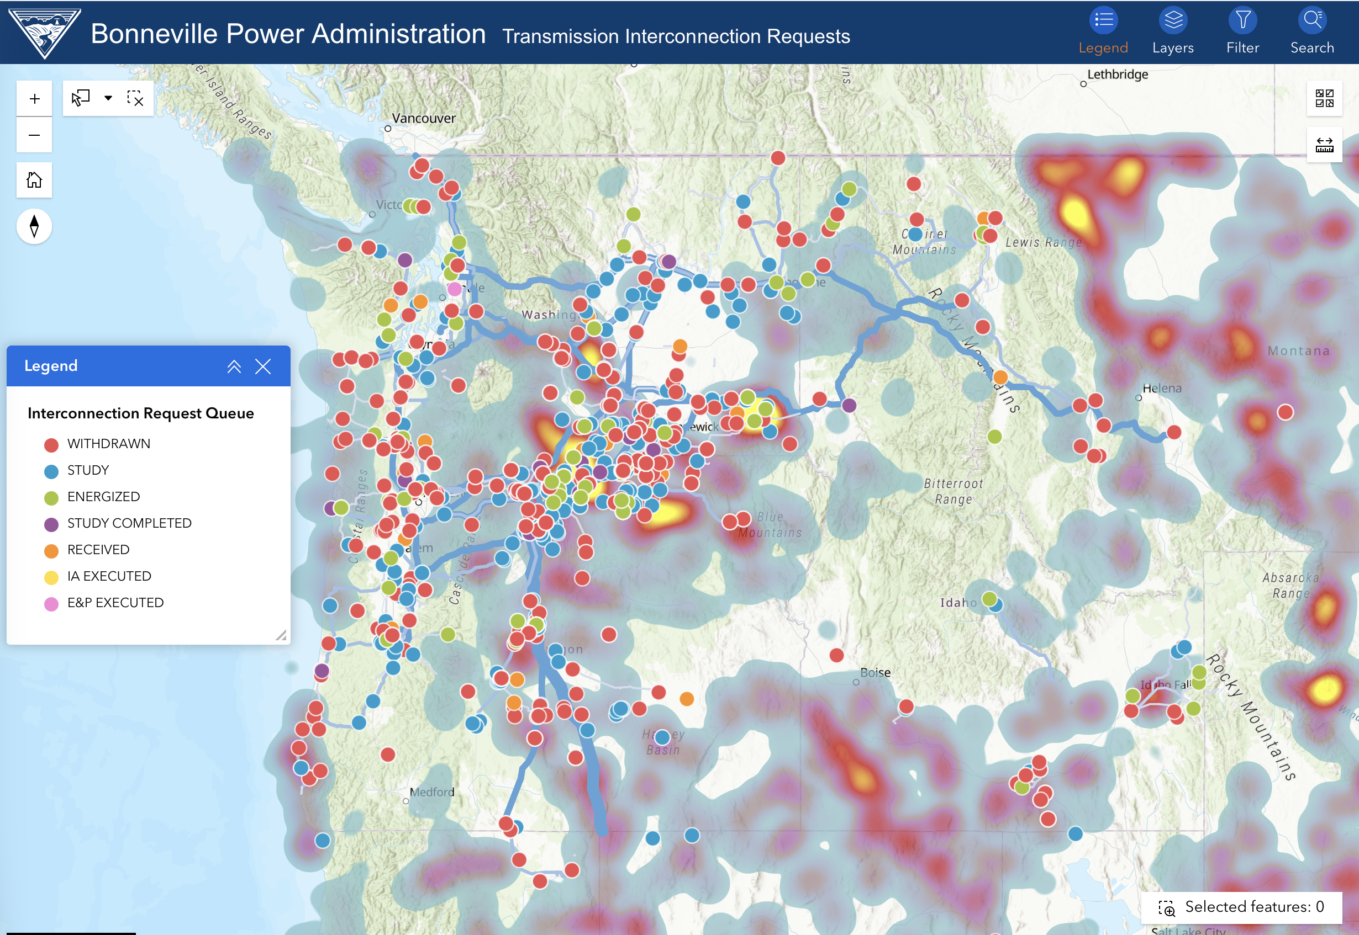

Slide 15
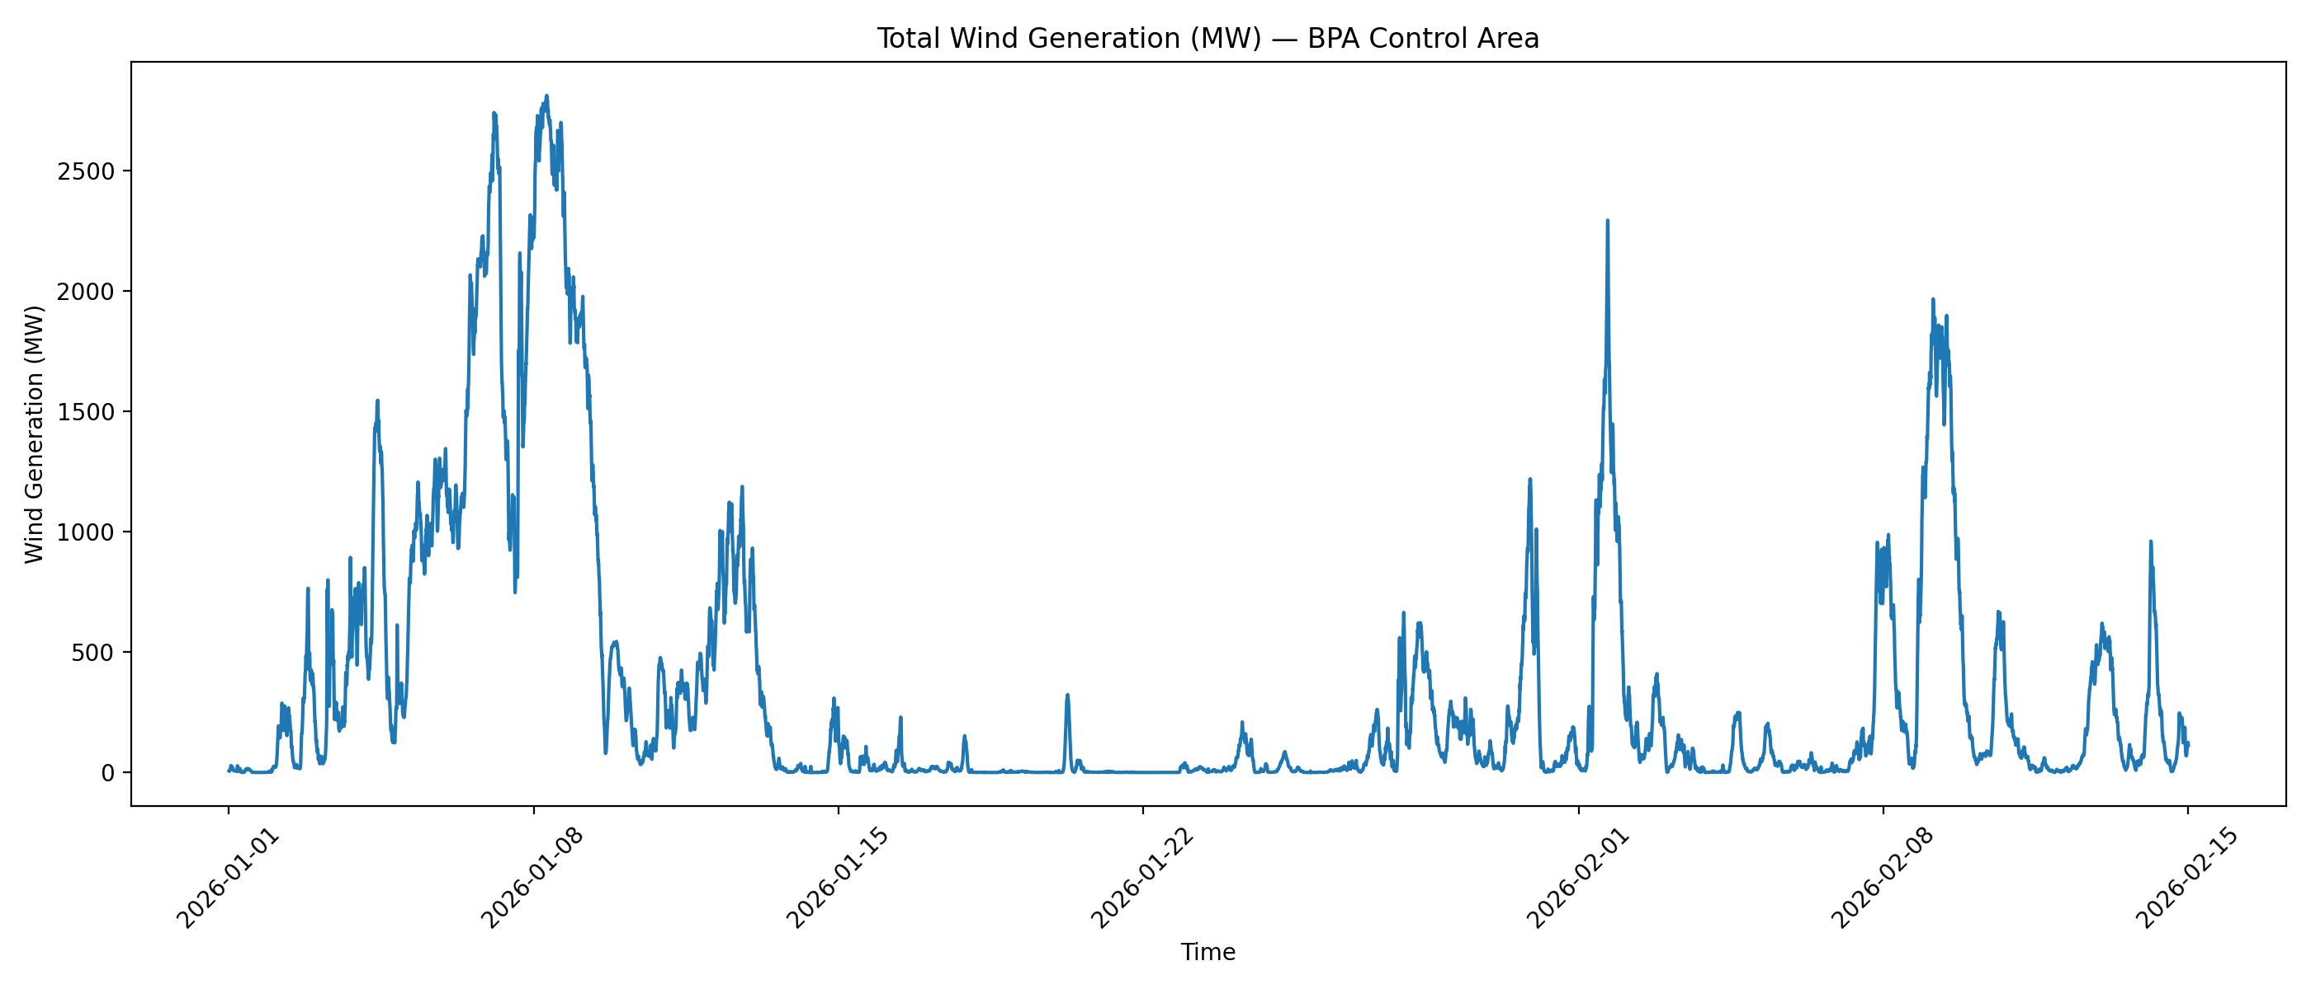
Jan 13 → last data point: wind energy, hours, capacity factor
Window: Jan 13, 2026 00:00 → Feb 14, 2026 23:55
Samples: 9,504 (5-minute)
Hours: 792.0 h
Total wind energy (Column E): 134,217.05 MWh = 134.217 GWh
Average wind output: 169.47 MW
With 3,031 MW nameplate → Capacity factor = 169.47 / 3031 = 5.59%

Slide 16
Evidence-backed project set (WA/OR/ID) — probability-weighted expected MW by end-2029
Total expected (this set): ~1.6 GW by 2030 (counting storage MW as “resource additions” alongside generation MW).
Bucket | Project (MW) | Public status evidence | “MW by 2030” assumption | P | Expected MW
Operating | OR Daybreak + Bakeoven (200) | Commercial operation announcement / facility pages | 200 | 0.95 | 190
Under construction | WA Ostrea (80) | EFSEC: “Under construction” | 80 | 0.90 | 72
Awaiting construction | WA High Top (80) | EFSEC: “Awaiting construction” | 80 | 0.60 | 48
Approved / phased build | OR Sunstone (up to 1200) | Approved not constructed; phased schedule extending to Feb 2030 | 600–1200 (see note) | 0.60 for 600, 0.30 for 1200 | 720 (expected)
Awaiting + contested | WA Horse Heaven (1150) | EFSEC: “Awaiting construction”; lawsuit/controversy coverage | 1150 | 0.15 | 173
Contracted dev | IDP “scheduled by end 2026” (325) | Idaho Power statement | 325 | 0.75 | 244
Contracted dev | Crimson Orchard (100 solar + 100 storage) | PPA / storage agreement coverage incl. June 1, 2027 | 200 | 0.80 | 160

Slide 17
WECC WARA (Western Assessment of Resource Adequacy): a Western-wide RA snapshot that emphasizes “hours at risk” and the deliverability/timing risk of planned projects (queue reality vs. plans).
NERC 2025 LTRA: a continent-wide reliability assessment; for your region it leans on WECC ProbA outputs and highlights where/when LOLE/EU iving the risk.
E3 WA RA Study deck (Sept 22 WA RA meeting): a Greater Northwest study framing theory and how much “effective capacity” current “in-development” projects contribute.
Northwest Power and Conservation Council 2029 adequacy assessment using multiple metrics (LOLEV, LOLH, EUE, Energy VaR) and explicitly stress-testing data-center and EE uncertainty.
PNUCC 2025 Northwest Regional Forecast: a forecast of loads/resources and utility plans, not a probabilistic RA model—but very useful as the “what utilities say will happen vs. what actually gets built” reality check.
Why they can look different: some are probabilistic RA studies (NWPCC, WECC ProbA/used by NERC, E3’s LOLP modeling), while PNUCC is a planning/forecast roll-up. Different scopes (West vs PNW vs Greater Northwest), different adequacy metrics, and different assumptions about imports/deliverability.

Slide 18
Nameplate → Energy → ELCC (three scenarios)
Assumptions:
Solar CF 22–28% (mid 25%); Wind CF 33–42% (mid 38%)
ELCC: solar 18%, wind 10%, battery 3% for 4-hour
Batteries are not net energy sources; they shift energy. (“Annual energy” below counts only solar+wind generation.)
Scenario results (what the math does)
Scenario (illustrative) | Solar MW | Wind MW | 4h Battery MW | Annual energy (GWh/yr) low–mid–high | Effective winter RA (MW) with 4h battery
Committed / scheduled (Ostrea 80 + Daybreak 140 + IDP 325 + Crimson 100 + 100 MW/4h storage) | 645 | 0 | 100 | ~1,244 – 1,413 – 1,582 | ~119 MW (645×0.18 + 100×0.03)
Reality-adjusted (add High Top 80 + Bakeoven 60 + expected partial Sunstone + small expected wind slice) | 1,225 | 173 | 100 | ~2,514 – 2,906 – 3,298 | ~239 MW
IRP-optimistic (Sunstone 1200 + Wagon Trail 500 + Obsidian 400 + Horse Heaven 1150 + the above) | 2,885 | 1,150 | 100 | ~9,380 – 10,770 – 12,160 | ~638 MW

Slide 19
Summary of conclusions
The report does not provide an auditable build schedule. It references high-level, aggregated additions (e.g., decade-scale totals) and simultaneously warns that assumptions are fragile. It does not give a project-by-project, year-by-year, by-type pipeline you can validate by permitting status, transmission readiness, and construction activity.
Interconnection queues are not forecasts. Public queue research shows heavy attrition and long timelines; therefore, “GW in the queue” is weak evidence for “GW built by 2030.” The queue functions more like an application backlog than a credible delivery plan.
Public siting/commission evidence for WA/OR/ID by 2030 is thinner than “2–5 GW” implies. When we restricted ourselves to what can be pointed to via siting-agency pages and regulator/utility documents (operating/under construction/scheduled), the “provable” near-term additions were much smaller than multi-GW narratives—unless you assume multiple large “approved/awaiting” projects actually mobilize and execute on time.
Nameplate MW headlines are misleading for adequacy. Even if you accept a 2–5 GW nameplate buildout, the effective winter capacity contribution is far smaller because ELCC/capacity credit for wind/solar (and short-duration batteries) is low during the Pacific Northwest’s risk events (multi-day winter cold snaps). In other words: GW nameplate does not close GW adequacy gaps without firming, long-duration storage, and/or major deliverable transmission.
The “drive-around-and-see-it” test is the right rebuttal. If the forecasted pipeline were real at the scale suggested, construction and transmission upgrade activity would be broadly visible. Instead, the observable landscape is dominated by permitting friction, litigation risk, upgrade cost/timeline constraints, and a large fraction of projects that never reach construction.

Slide 20
Washington’s statutory 2030 target is 50 MMT CO₂e (45% below 1990).
The latest audited inventory shows 96.1 MMT in 2021, implying a required reduction of ~46 MMT by 2030 (~5.1 MMT/yr).
Electricity is ~19.5% of emissions (18.7 MMT in 2021), so even rapid grid decarbonization cannot achieve the economywide target without large, concurrent reductions in transportation and buildings.
Meanwhile, public siting and permitting timelines for major clean resources and transmission do not currently provide a verifiable, construction-backed pathway consistent with the pace required.

Slide 21
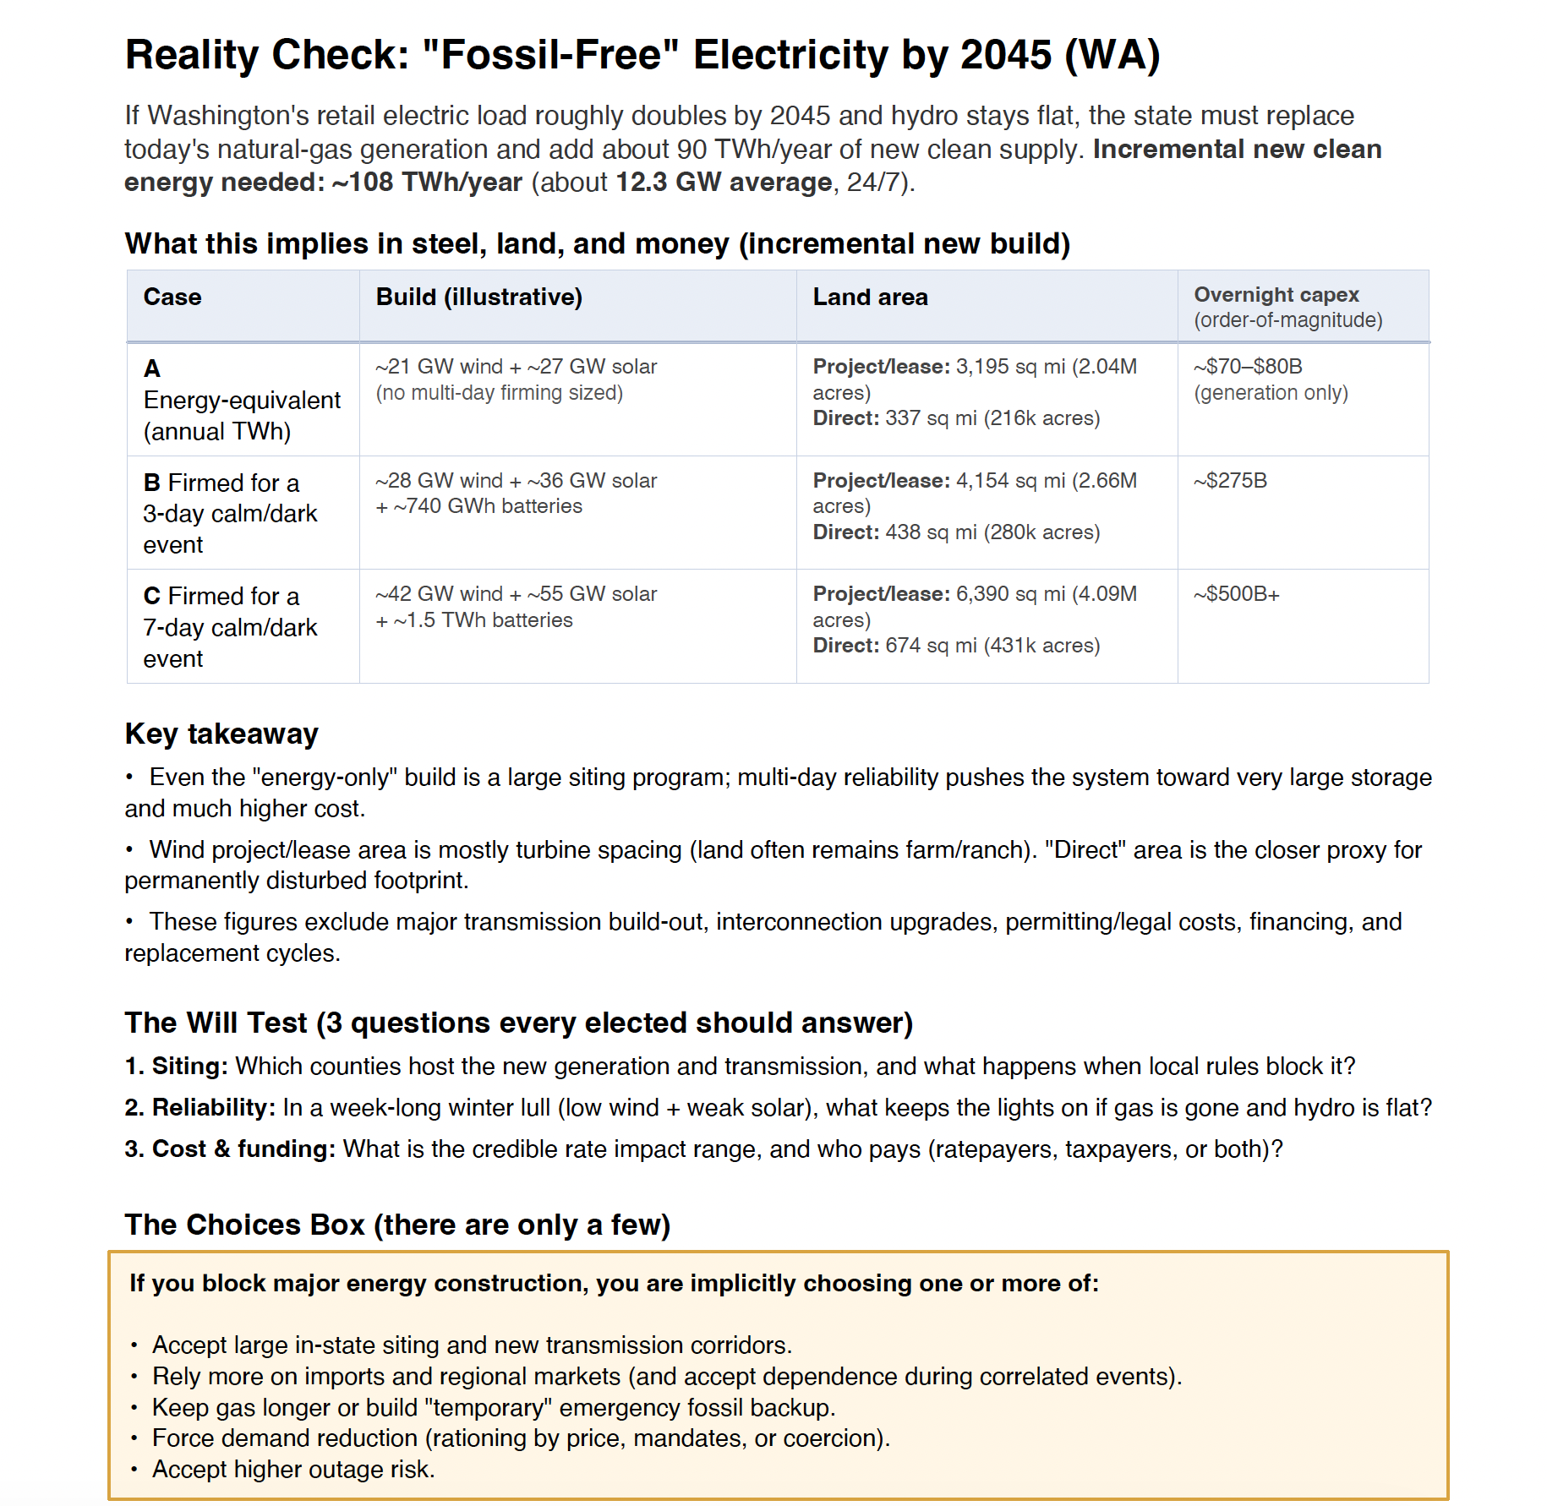
 |  | Project/lease: 3,195 sq mi (2.04M acres) Direct: 337 sq mi (216k acres) | ~$70-$80B (generation only)
 |  | Project/lease: 4,154 sq mi (2.66M acres) Direct: 438 sq mi (280k acres) | ~$275B
 |  | Project/lease: 6,390 sq mi (4.09M acres) Direct: 674 sq mi (431k acres) | ~$500B+

Slide 22
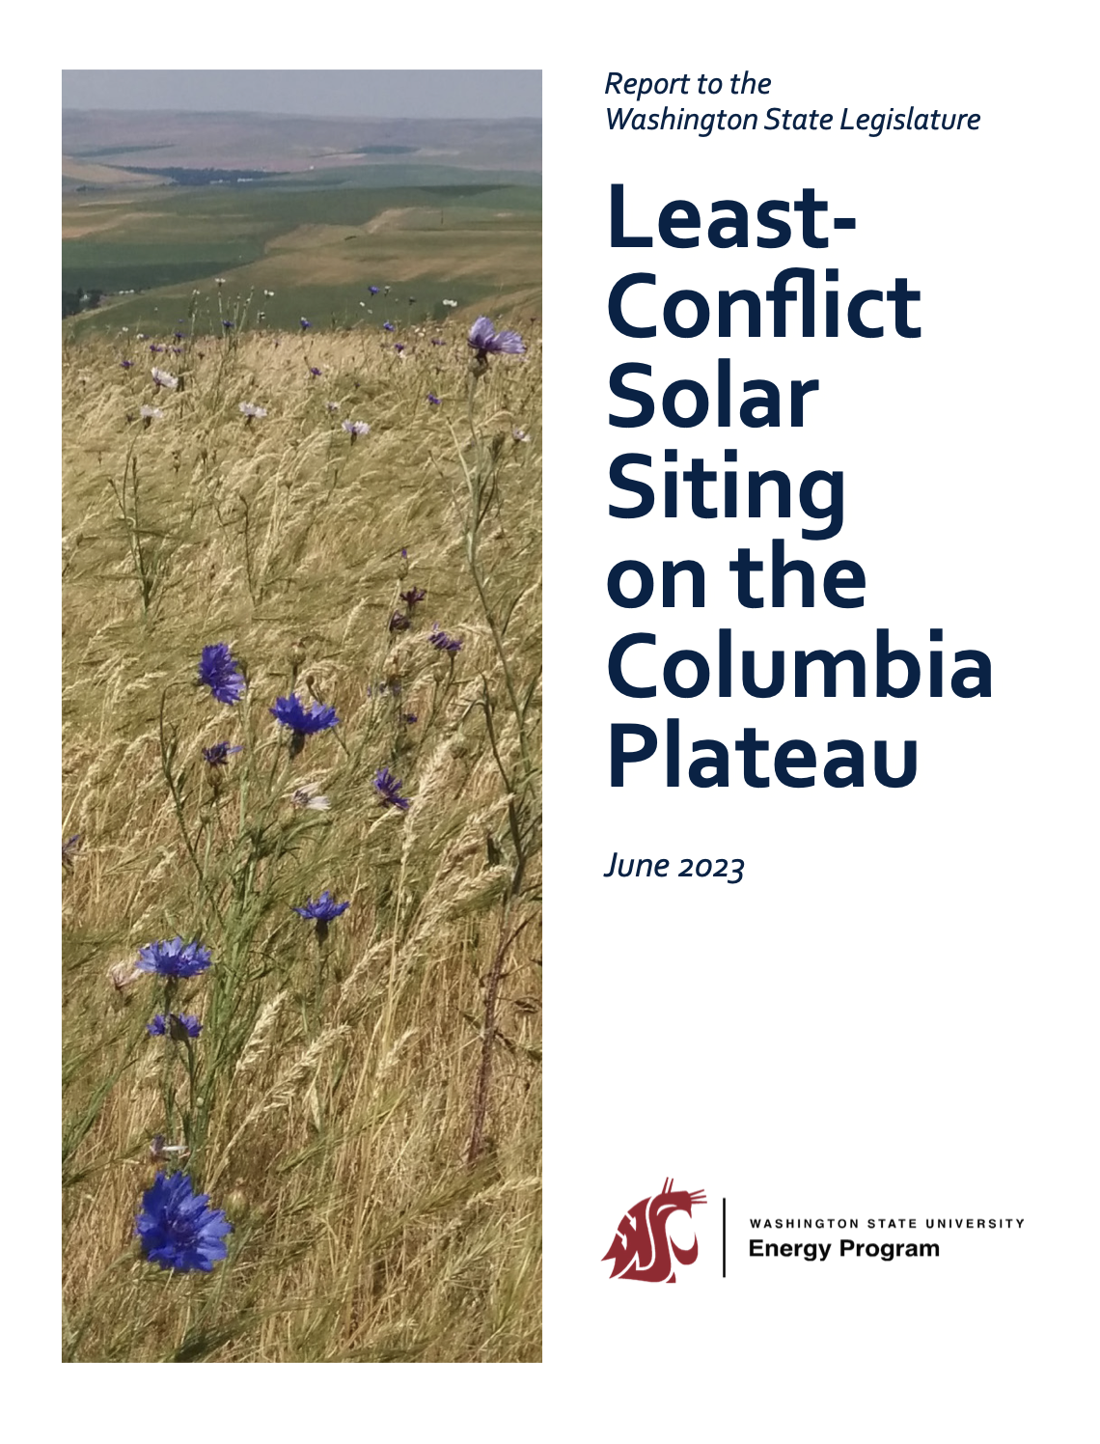
The headline number: “least-conflict across all values” is small
• Study area analyzed: ~14.24 million acres. ￼
• “High suitability” area: ~6.78 million acres (47.6%). ￼
• If you require low conflict simultaneously for environmental conservation + farmland + ranchland, the area drops to ~211,954 acres—about 3.13% of the suitable area. ￼
Planner implication: If local policy language effectively demands “no meaningful impact to any valued resource,” you are implicitly forcing development into a very narrow set of places (or out of your jurisdiction). That tradeoff should be made explicit in goals/policies.
⸻

Slide 23
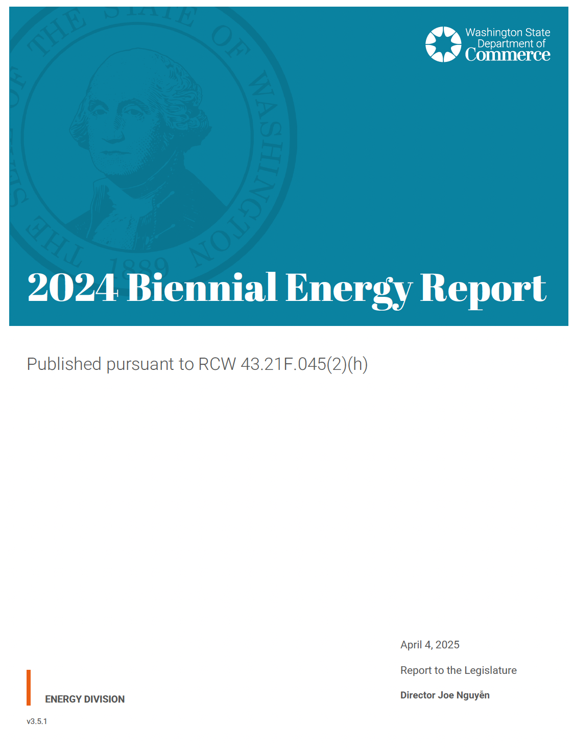
Where it points out obstacles:
• It directly states that siting, building, and interconnecting clean electricity fast enough to match demand is a “complex challenge” requiring solutions to “multiple problems at once,” and calls these “obstacles” needing better procedures, planning, and market structures. ￼
• It flags transmission as a gating issue: expanding transmission capacity is needed for a balanced clean-energy portfolio; meanwhile, demand-side and distributed solutions can often be developed faster than transmission and large-scale generation. ￼
• On permitting, it cites an independent evaluation that found Washington’s permitting process “requires significant reform,” including recommendations spanning staffing/funding, SEPA, EFSEC, local government, and planning for generation/transmission. ￼
• It also notes coordinated permit consolidation ideas exist, but “additional work will be needed” with engagement from industry, local/state government, tribes, and communities. ￼
Bottom line: The report’s “progress” is largely about actions taken and programs launched (process outputs), while the obstacles section is fairly blunt that siting/permitting reform, transmission buildout, and interconnection pace are structural challenges. ￼

Slide 24
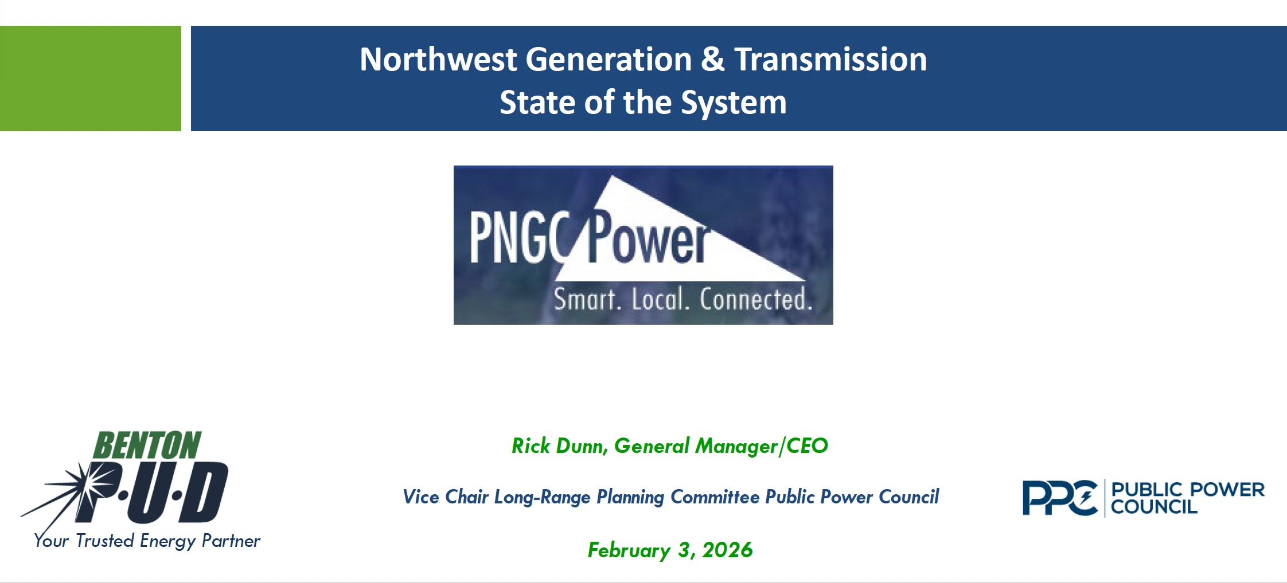

Slide 25
What the deck is saying:
Load growth is accelerating and increasingly dominated by data centers (especially in Oregon/UEC territory). The deck shows UEC data-center retail load jumping from 215 aMW (2016) to 1,259 aMW (2024) and projecting ~3,020 aMW (2030) and ~3,827 aMW (2033)—framed as a major driver of regional growth.
The Northwest is bumping into reliability limits in winter, and recent peaks are beating forecasts. It highlights Feb 2025 winter peak ~35,700 MW (exceeded forecast “without a weather event”) and July 2024 summer peak ~33,300 MW.
Mixed messaging from adequacy institutions: the deck juxtaposes warnings (e.g., NERC risk messaging) with “adequate/not adequate” framing from the NWPCC, implying the region is getting conflicting signals about how tight things really are.
Hydro is foundational but increasingly “spoken for” and highly variable—so “surplus energy” doesn’t equal reliability. It emphasizes BPA hydro variability and that firm energy is committed to firm load service, with annual deficits growing in the outlook.
January 12–16, 2024 is used as the cautionary tale: hydro short, gas maxed, wind collapsed, and the Northwest relied on imports for all 120 hours—with “no net energy from California generation” called out.
Capacity value (ELCC) is the knife-edge problem. The deck stresses that planning is about effective capacity during critical hours, not annual MWh averages, and claims storage ELCC diminishes quickly and remains vulnerable to multi-day/ multi-week low renewable output.
It argues wind/solar “replacement” ratios for firm capacity are huge. Example claims include: 4,000 MW to 18,000 MW of wind (depending on conditions) to “replace” 1,000 MW firm, and 6,700 MW to 30,000+ MW of solar to “replace” 1,000 MW firm.
The E3 “Phase 1” resource adequacy message is blunt: demand rising fast, retirements outpacing builds, wind/solar/batteries contribute only modestly to peak reliability, and shortages may begin in 2026 during winter cold spells.
Costs are rising for “incremental” power: it flags BPA Tier 2 rates up ~170% since 2019, tying this to the wholesale cost of serving load above Tier-1 allocations (and mentions WA CCA carbon cost context).

Slide 26
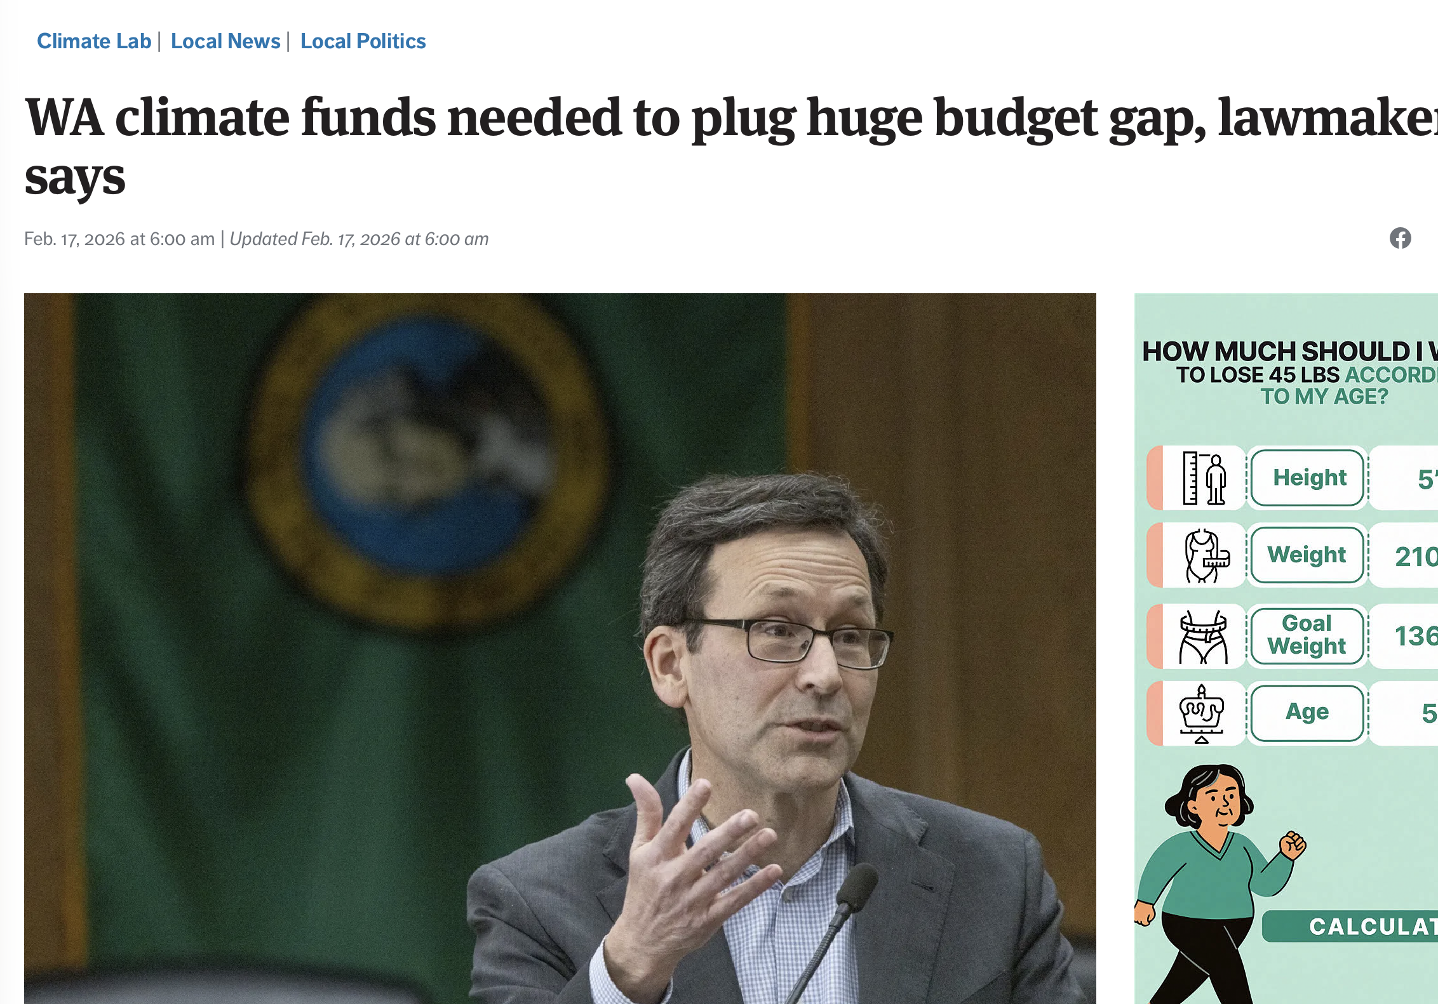
Seattle Times Feb 17 2026
Lawmakers can’t find a better way to fill part of Washington’s perennial budget gap than by dipping into the billions raised by the state’s Climate Commitment Act.
Many had hoped to avoid tapping into the dedicated climate account for general-fund obligations, but as the budget deadline approaches alongside the end of the short legislative session early next month, they weren’t able to find any viable alternatives.
Gov. Bob Ferguson’s $559 million proposal to transfer climate funds is legal but also a significant disappointment for those who hoped to safeguard that cash as a way to transition away from planet-warming fossil fuels or to guard against natural disasters, especially as the federal government hastens its retreat on climate change policy.

Slide 27
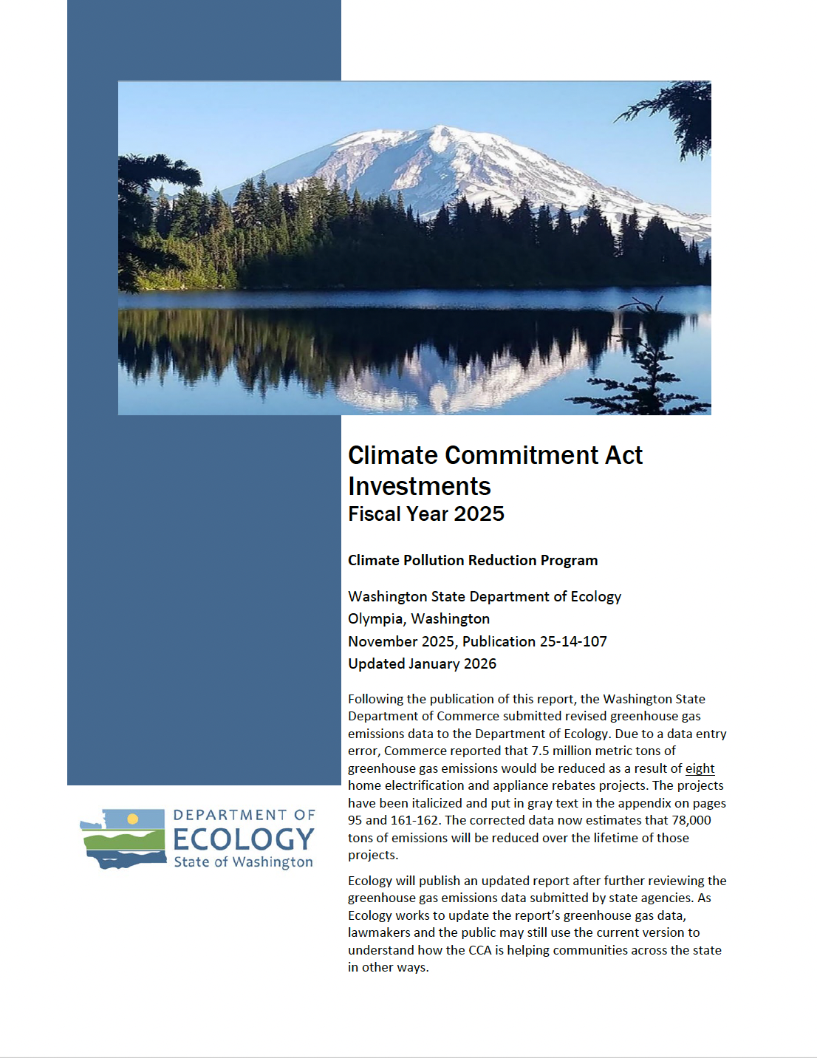
565 pages…
Using the FY2025 “appropriation title → fiscal year 2025 expenditure amount” roll-ups that are clearly grid/renewables oriented:
Electrical Grid Integration and Innovation (Commerce): $21,464,441
Emerging Clean Energy Generation (Commerce): $6,656,857
SB 5165 Electric Transmission Planning: $2,047,444

Slide 28
The Grid Transition -- 2026
“E ni kaita mochi” is a Japanese proverb used to describe
something that looks appealing but is
ultimately impractical, or impossible
to achieve, similar to the English idiom "pie in the sky"
It’s nice to look at – but you can’t eat it!

